Slide 1
Sample Project for CSCI 434/534
Department of Computer Science
William & Mary

Slide 2


Objective
Monitoring and Analyzing computer network traffic, particularly from popular internet websites such as Google, Facebook, and YouTube.
Extracting features from website traffic data and build models to classify the specific website from which the traffic originated.
The classification is done automatically, without access to the website URL or data payload that is typically encrypted.
Figure source: https://hellofuture.orange.com/en/encrypting-or-classifying-internet-traffic-do-we-have-to-choose/
Notes:
Inner product

Slide 3

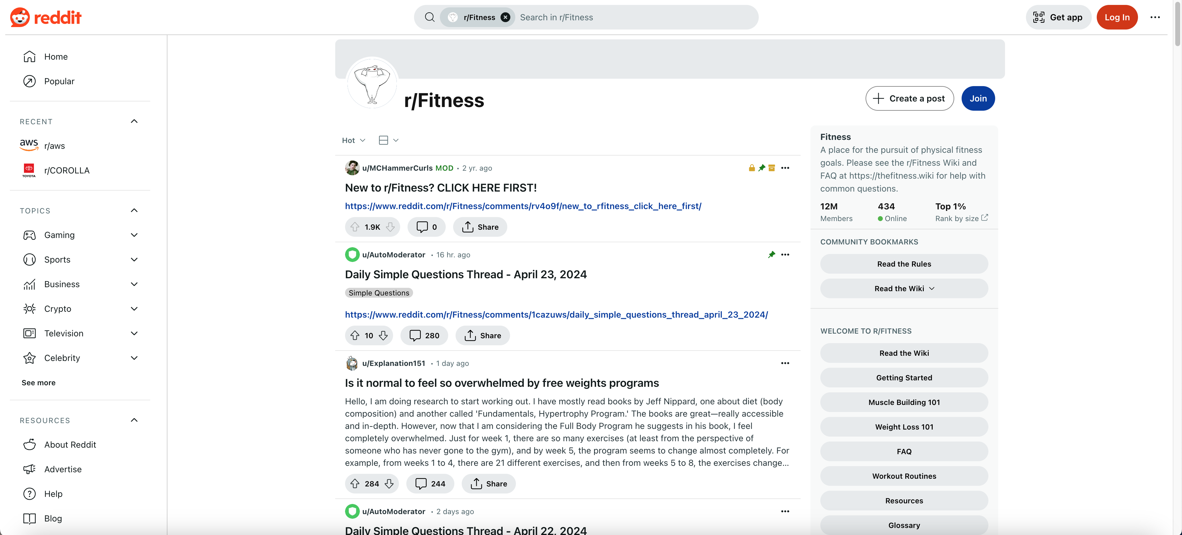
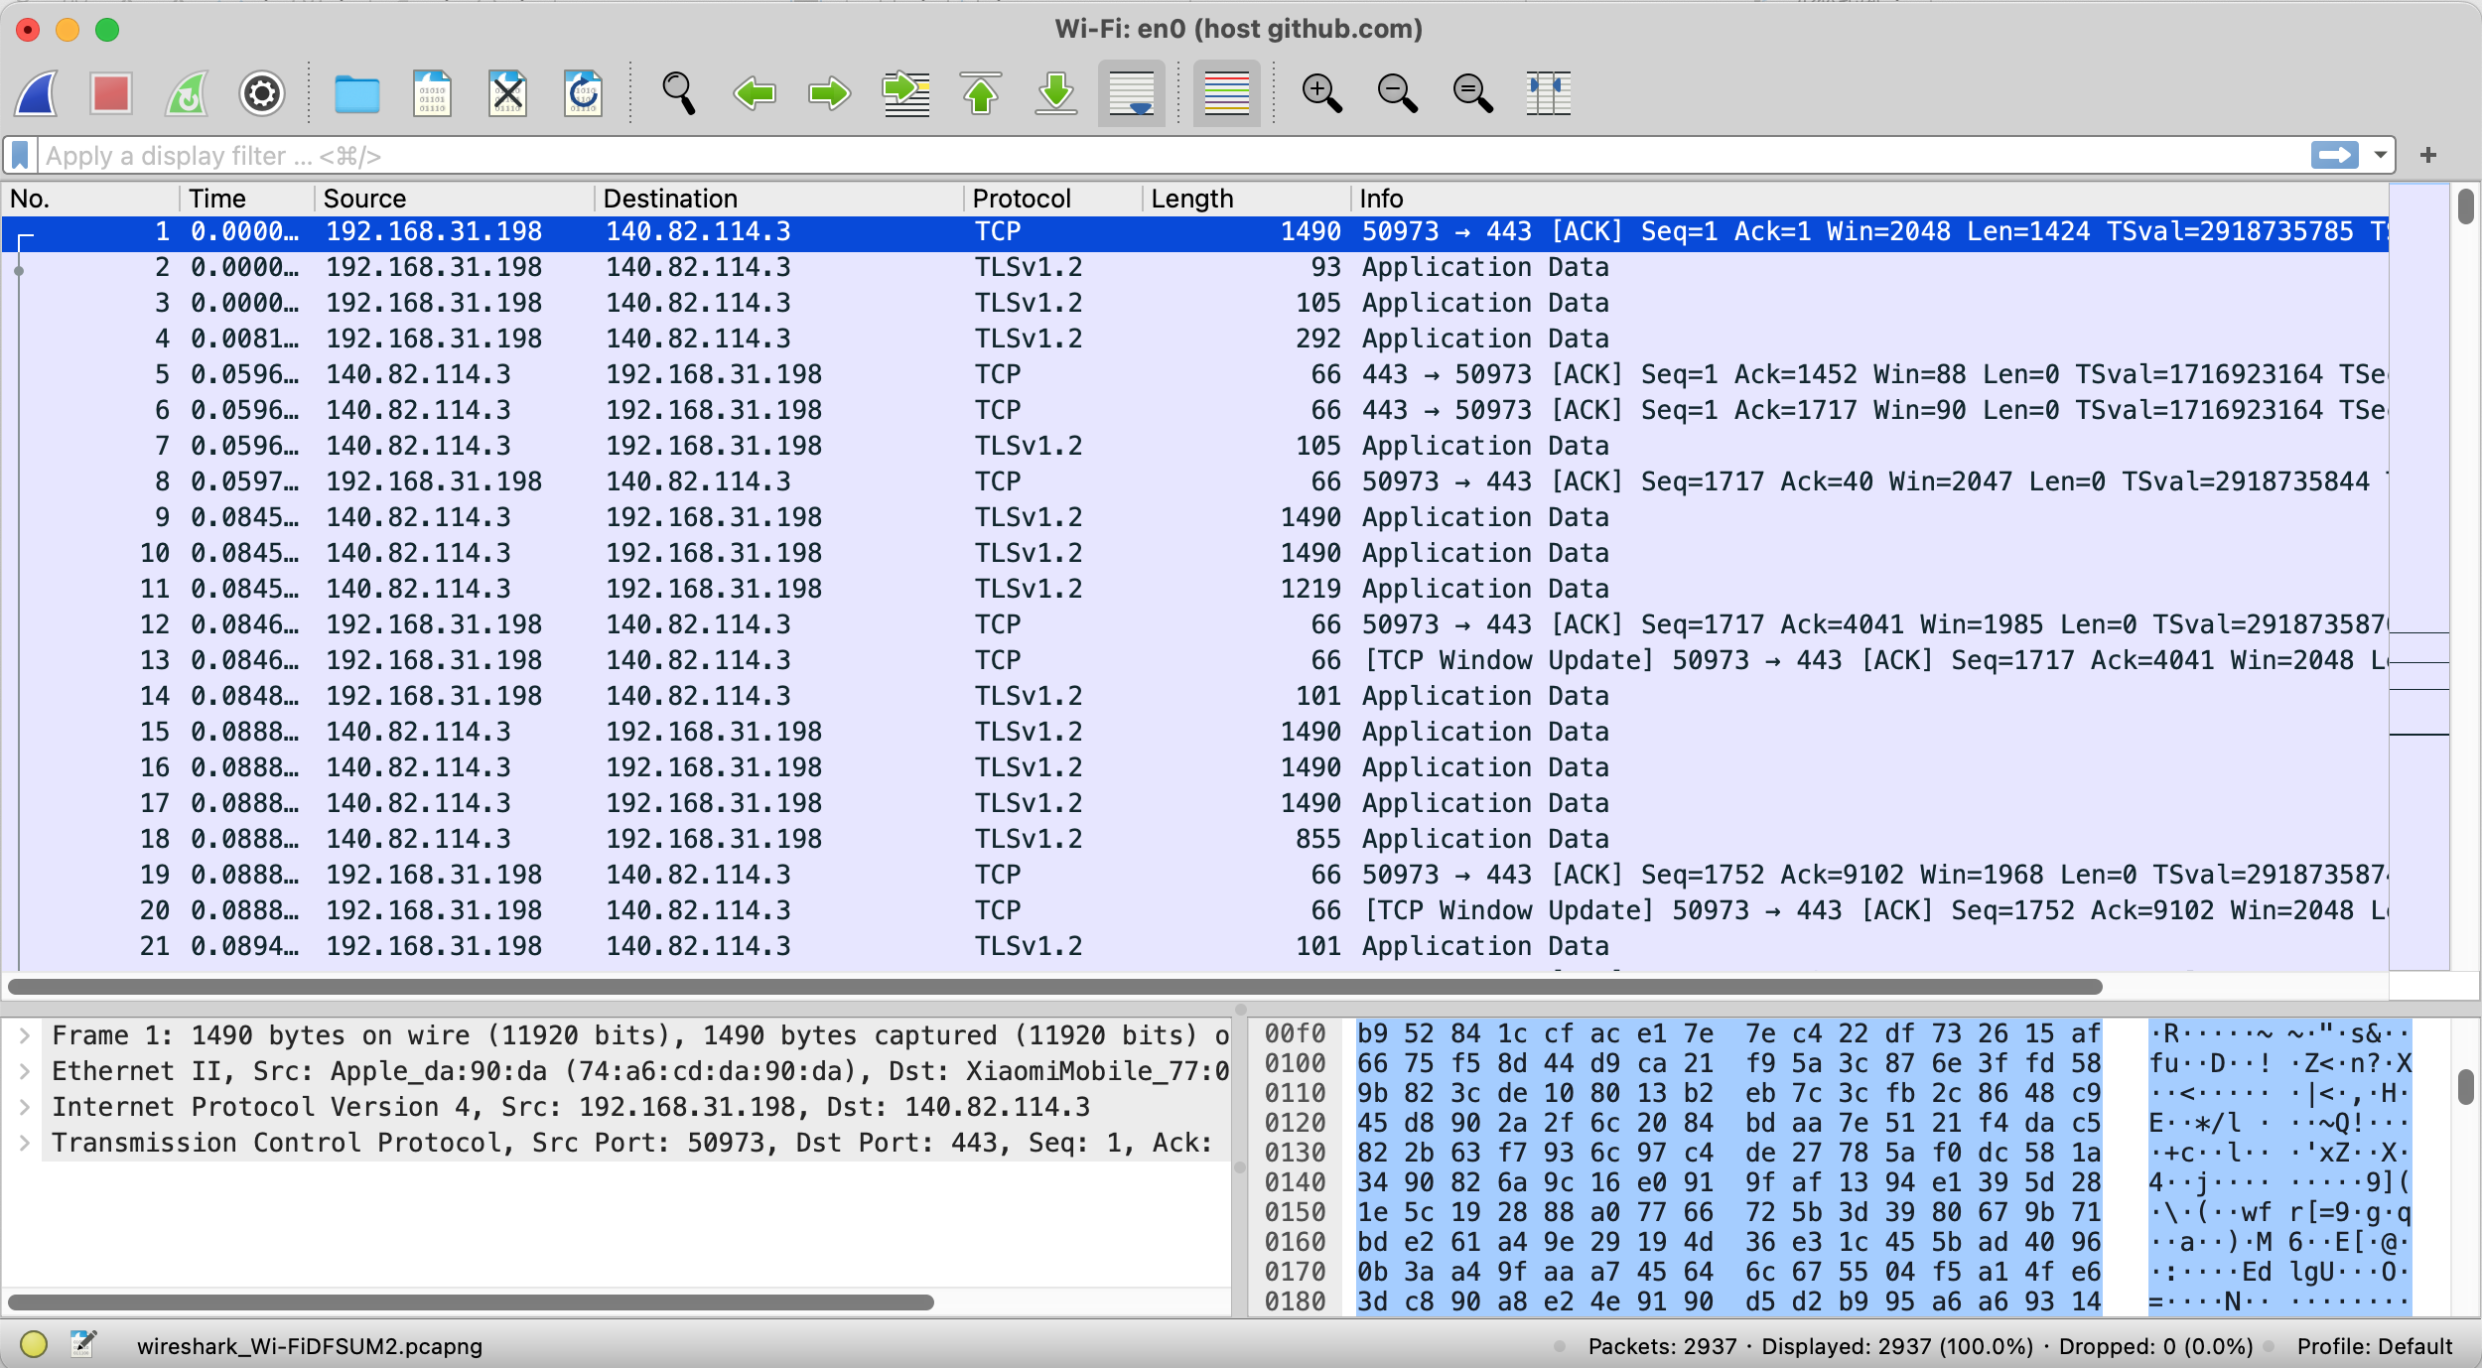
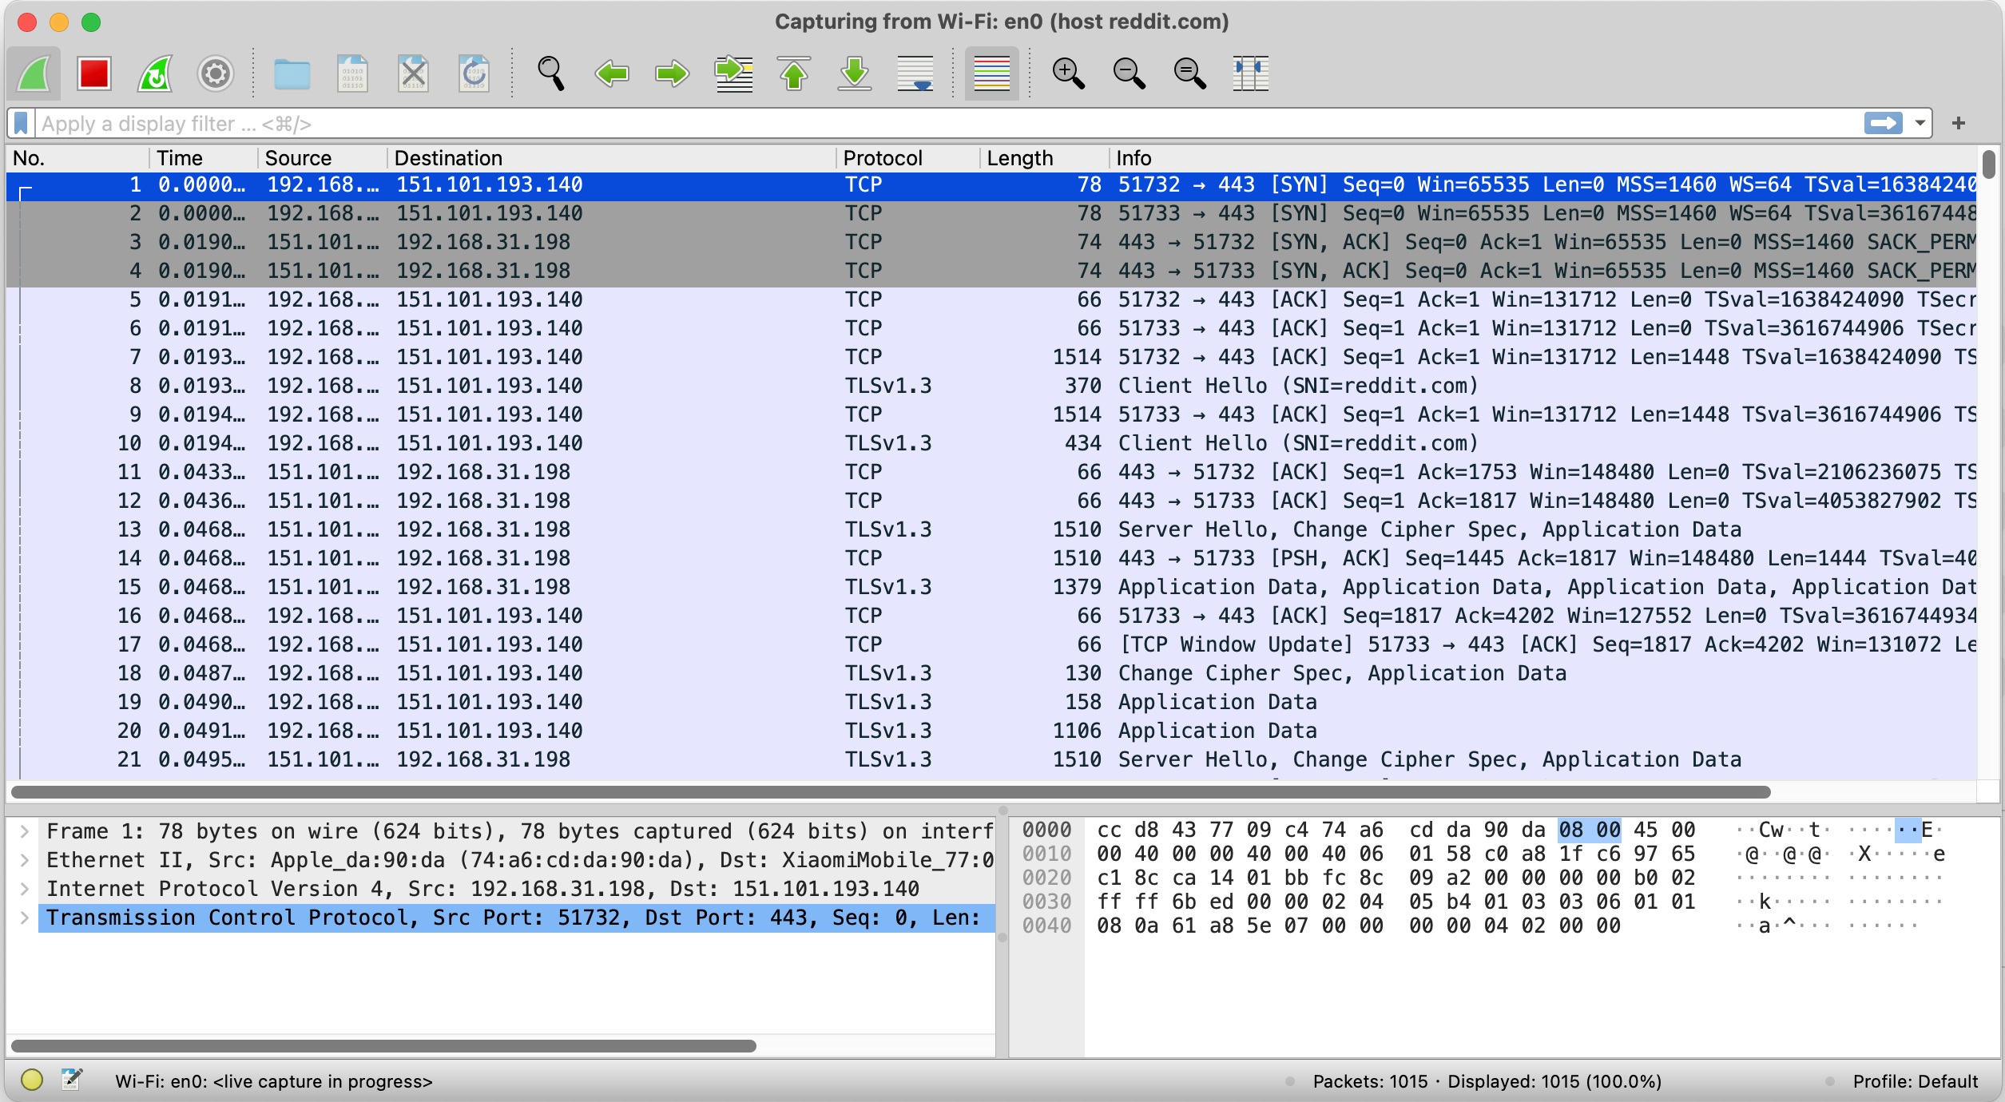
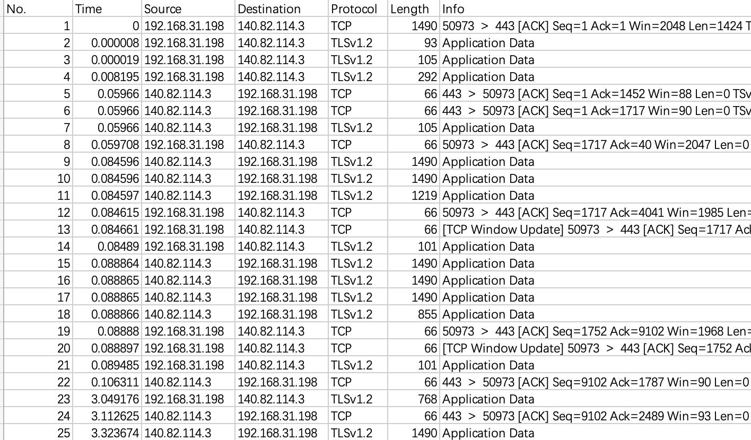
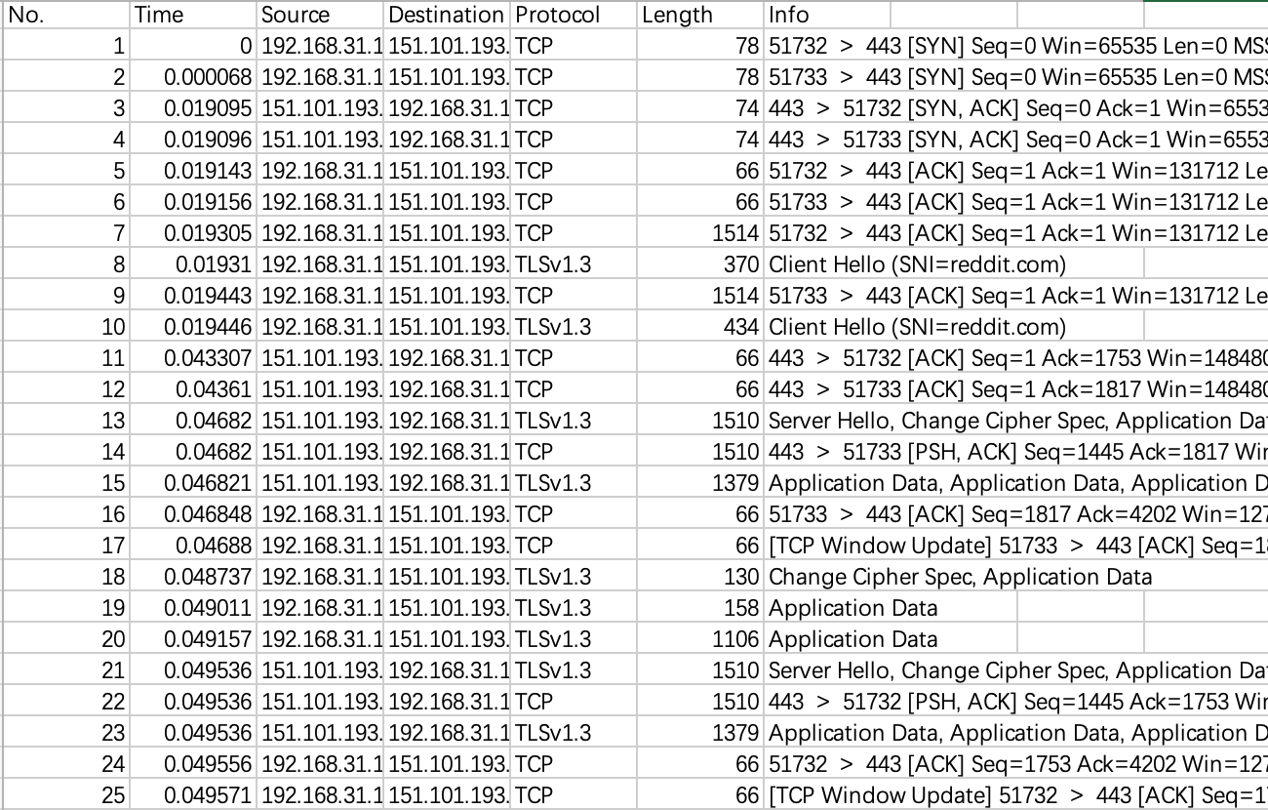
Data Collection
GitHub
Reddit
Visited Website
Wireshark Collected Data
LinkedIn
Instagram
Weather
…
Exported Data
Notes:
Inner product

Slide 4




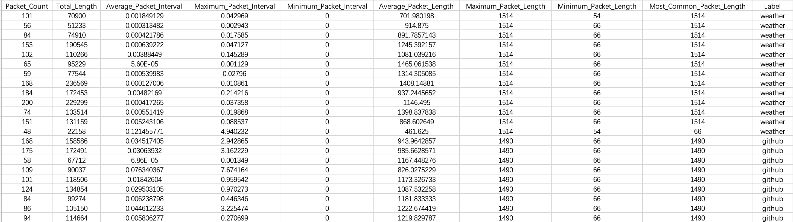
Feature Engineering
Visited Website
Wireshark Collected Data
Extracted Features
Packet Count
Total Length
Average Packet Interval
Maximum Packet Interval
Minimum Packet Interval
Average Packet Length
Maximum Packet Length
Minimum Packet Length
Most Common Packet Length
…
…
Dataset Size
Dataset Samples
Label | Size
GitHub | 24
Instagram | 10
LinkedIn | 18
Reddit | 9
Weather | 13
Total | 74
Notes:
Inner product

Slide 5
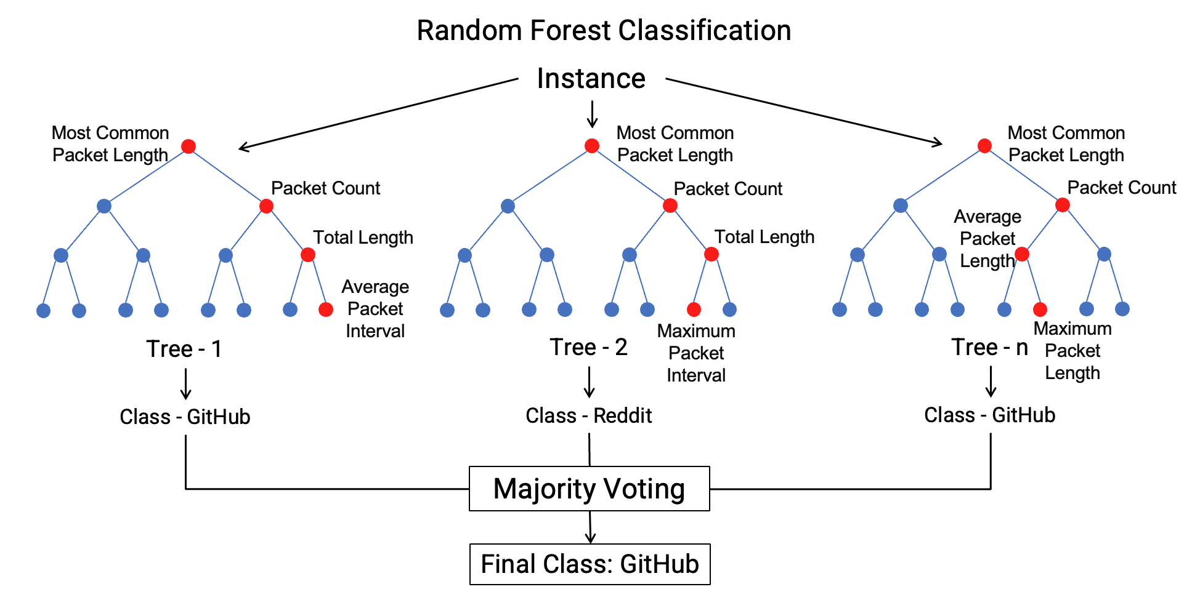
Model – Random Forest
Definition: Random Forest is an ensemble learning method used for classification and regression. It builds multiple decision trees and merges them together to get a more accurate and stable prediction.
How It Works:
Bootstrap Aggregating: Randomly selects samples from the data set to build multiple decision trees.
Feature Randomness: At each split during the construction of a tree, a random subset of features is considered.
Majority Voting (Classification) / Averaging (Regression): Each tree makes a prediction. The mode (classification) or mean (regression) of these predictions is taken as the result to improve accuracy and control over-fitting.
Baselines:
Linear Regression
Logistic Regression
Notes:
Inner product

Slide 6
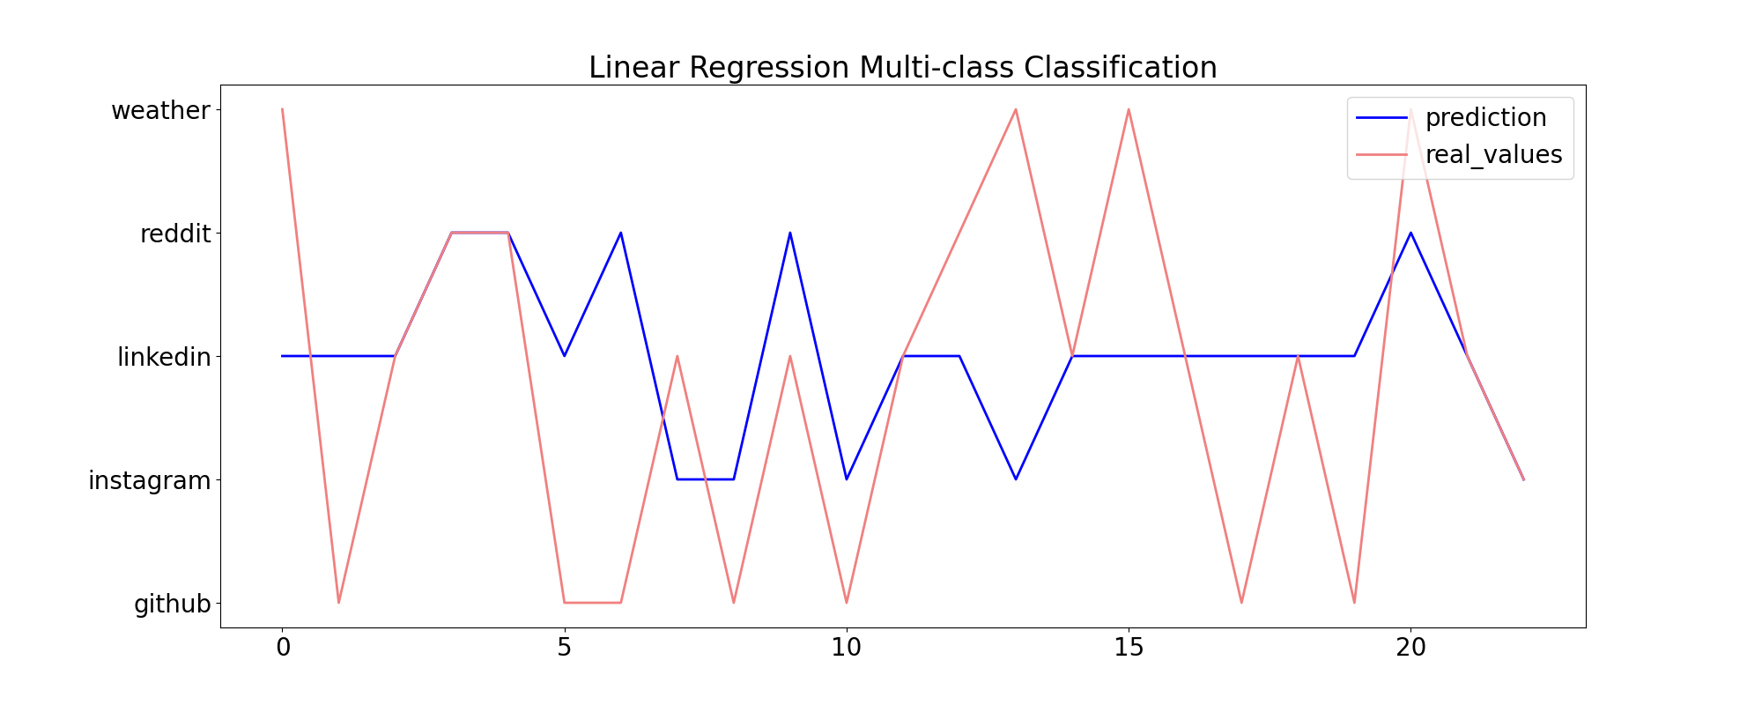
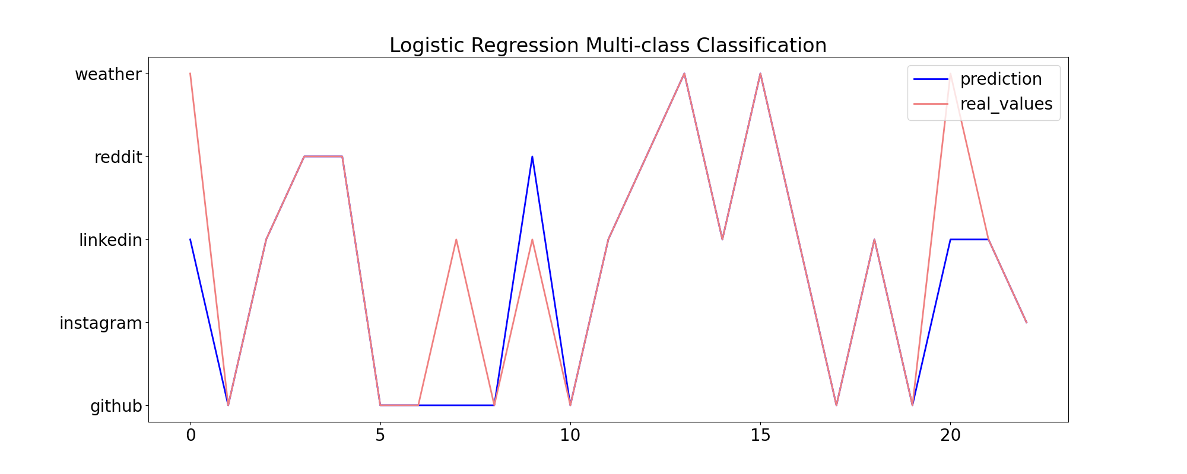
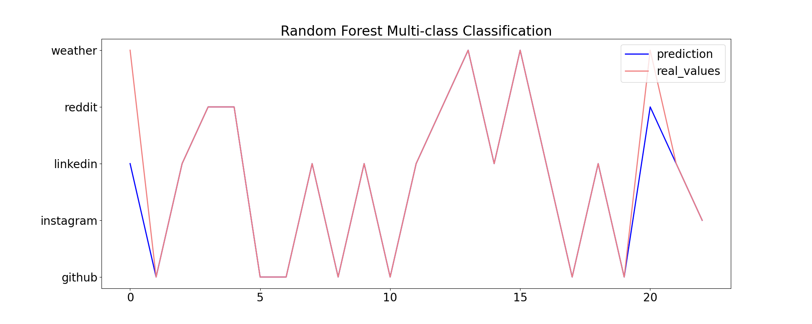
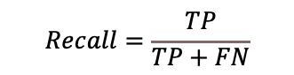
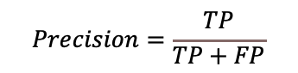
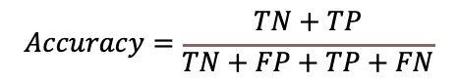
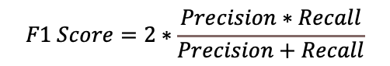
Result
Evaluation Results (Train/Validation/Test: 6:2:2)
Linear Regression
Model | Accuracy | Marco F1 Score
Linear Regression | 0.39 | 0.28
Logistic Regression | 0.83 | 0.84
Random Forest | 0.91 | 0.89
Logistic Regression
Model Performance: Achieved an accuracy of 0.91 and a macro F1 score of 0.89, significantly outperforming baseline models (Linear Regression and Logistic Regression).
Visual Analysis of Test Samples: Demonstrates that Random Forest predictions closely align with actual values, unlike the large discrepancies observed in Linear Regression and Logistic Regression predictions.
Random Forest
$$Precision=\frac{TP}{TP+FP}$$
$$Recall=\frac{TP}{TP+FN}$$
$$Accuracy=\frac{TN+TP}{TN+FP+TP+FN}$$
$$F1 Score=2∗\frac{Precision∗Recall}{Precision+Recall}$$
Note: TP = True positive; FP = False positive; TN = True negative; FN = False negative.
Notes:
Inner product

Slide 7
If you really do NOT like the AI/ML-based network traffic analysis project, please let me know.
An alternative is to build network reliability (TCP) with an unreliable UDP
TCP state machine
Please send me an email if you want to pursue this alternative

